Slide 1




World Population Analysis
Akashdeep Dam
Intern at Unified Mentor

Slide 2
Agenda
Introduction
Techniques
Primary Goals
Analysis
Summary

Slide 3

Introduction
We analyzed the data of world population from 1970 to 2022. Here we analyzed the data and provided insights of data for countries, continents and whole world. We have shown the demographics of population growth in year to year according to countries, continents and world. Also, we implemented machine Learning models and Numpy to show the population growth trends and predicted population growth for year 2030.
3

Slide 4

Techniques
Programming Language : python
Data cleaning : numpy & pandas
Data analysis : numpy & pandas
Infographics : matplotlib, seaborn & plotly
Models : scikit-learn – linear regression & random forest

Slide 5
Primary Goals
Year-wise population by countries
Top 5 countries by population in a year
Year-wise population by continents
Machine learning models to predict the population
Predict the population of a country in 2030
Predict the population of a continent in 2030
Population trends worldwide from 1970 – 2022
Predict the population of world in 2030
5

Slide 6
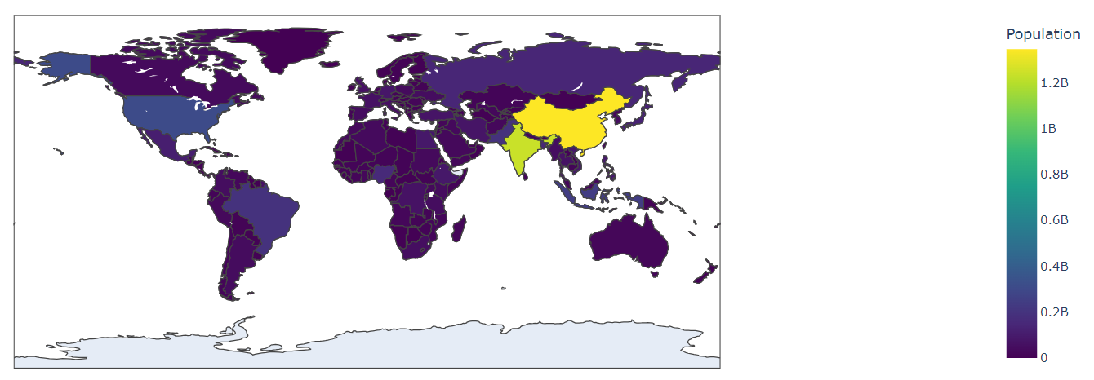
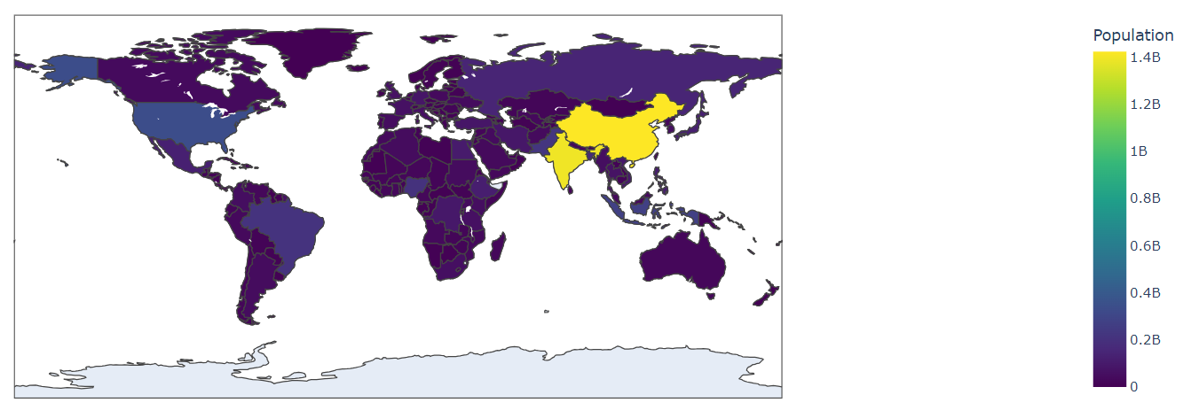
Analysis | Total Population Over The World in Recent Years ( 2010 & 2020 )
2010
2020
6

Slide 7
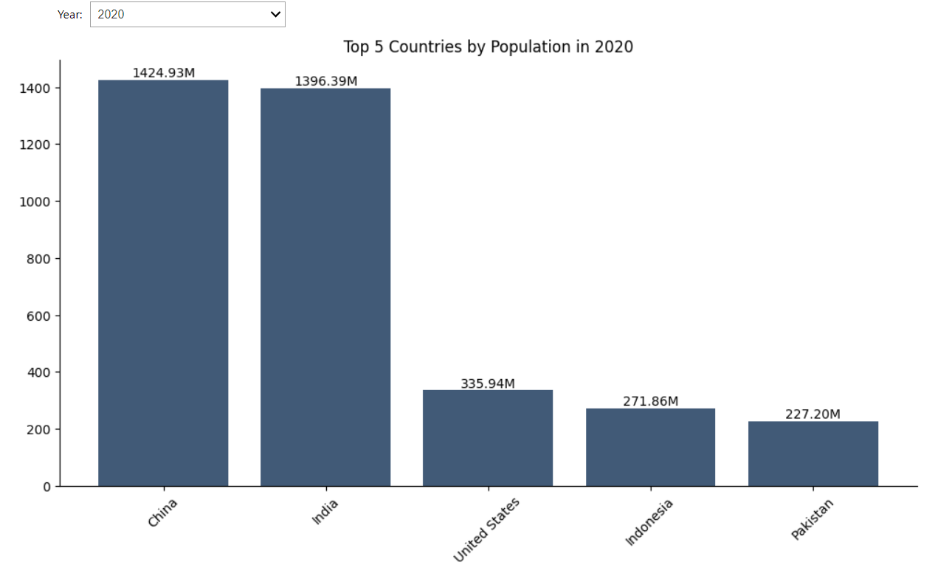
Analysis | Top 5 Countries Population in Selected Year - 2020
Here, in 2020, China had the most population among world. The next one most populated country was India.
In 2020 the top 5 countries by population were :
China – 1424.93 M
India – 1396.39 M
United States – 335.94 M
Indonesia – 271.86 M
Pakistan – 227.20 M
7

Slide 8
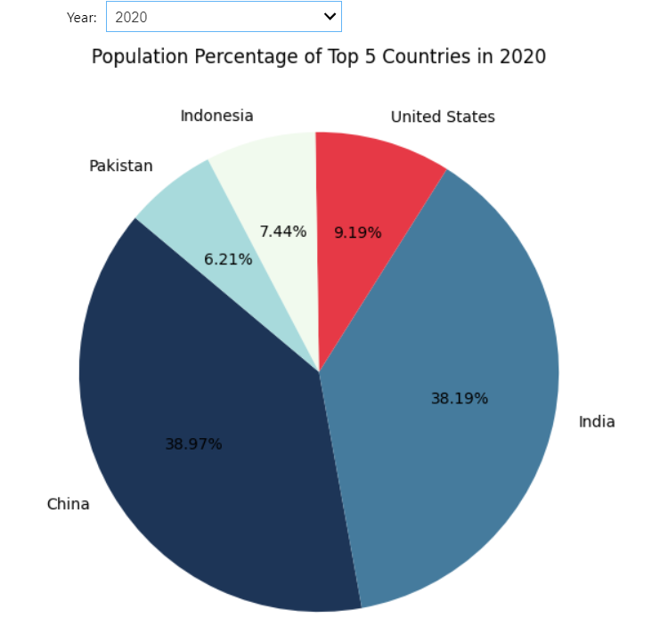
Analysis | Top 5 Countries Population Percentage by Year : 2020
Here, China & India hold most percentage of total population in the world.
In 2020 population percentage of top 5 countries are :
China – 38.97 %
India – 38.19 %
United States – 9.19 %
Indonesia – 7.44 %
Pakistan – 6.21 %
8

Slide 9
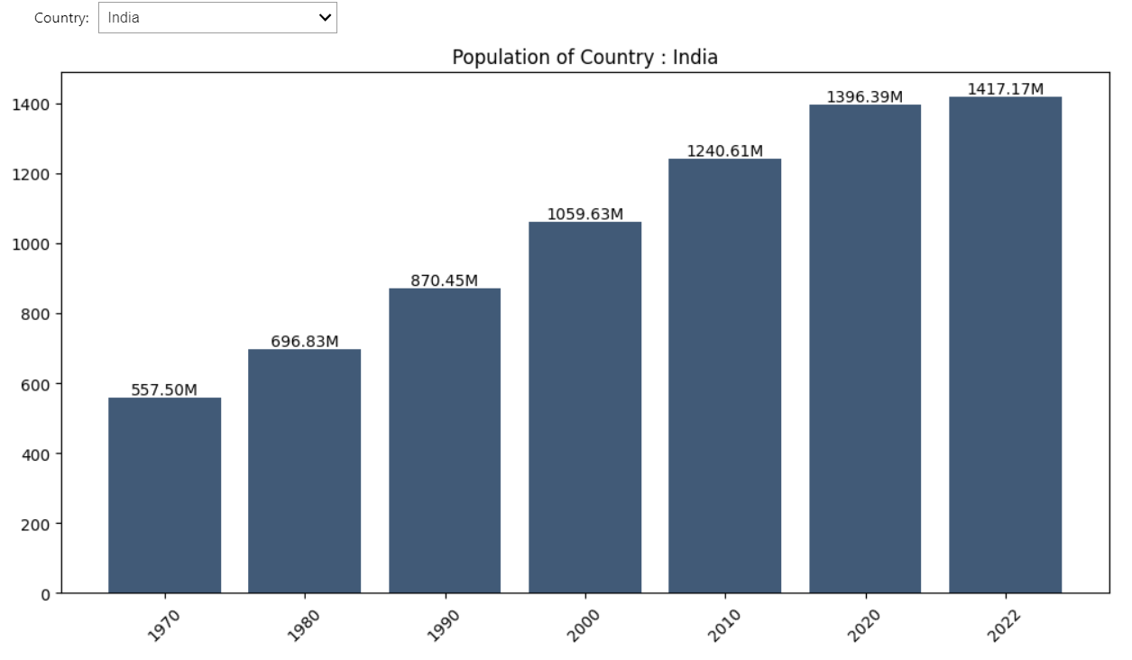
Analysis | Year-wise Population by Selected Country - India
Here, in India, from 1970 to 2022, population was increasing gradually in positive manner.
In 2022 population was the most among all years in India.
1970 – 557.50 M
1980 – 696.83 M
1990 – 870.45 M
2000 – 1059.63 M
2010 – 1240.61 M
2020 – 1396.39 M
2022 – 1417.17 M
9

Slide 10
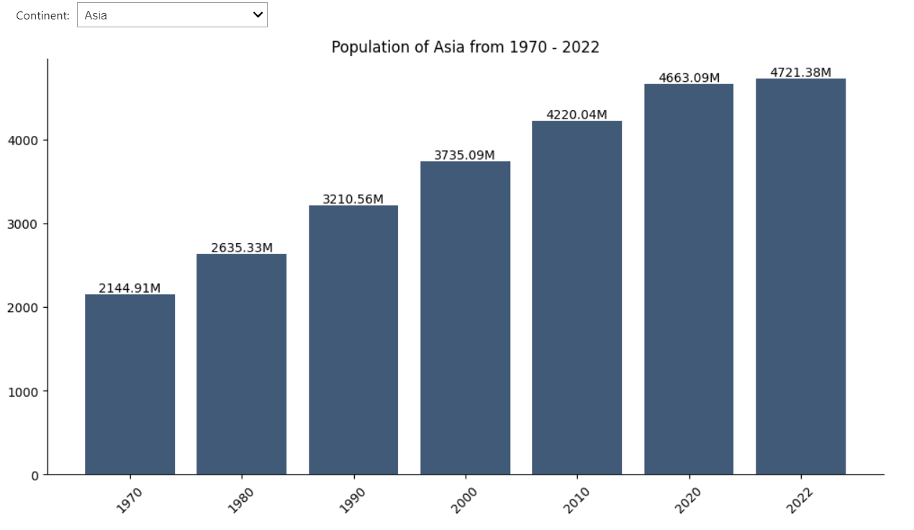
Analysis | Year-wise Population by Selected Continent - Asia
Here, in Asia, from 1970 to 2022, population was increasing gradually in positive manner.
In 2022 population was the most among all years in Asia.
1970 – 2144.91 M
1980 – 2635.33 M
1990 – 3210.56 M
2000 – 3735.09 M
2010 – 4220.04 M
2020 – 4663.09 M
2022 – 4721.38 M
10

Slide 11
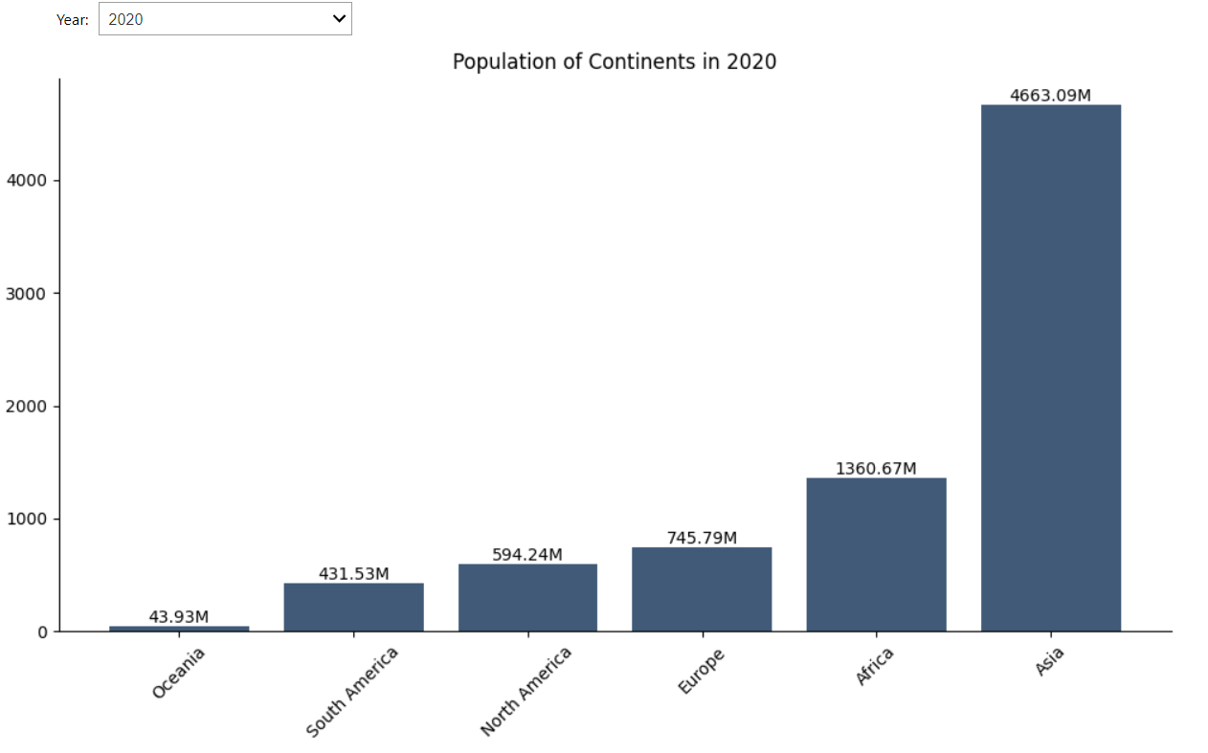
Analysis | Continent-wise Population by Selected Year - 2020
Here, in 2020, among all continent, population was the most in Asia.
In 2020 population of continents were :
Oceania – 43.93 M
South America – 431.53 M
North America – 594.24 M
Europe – 745.79 M
Africa – 1360.67 M
Asia – 4663.09 M
11

Slide 12
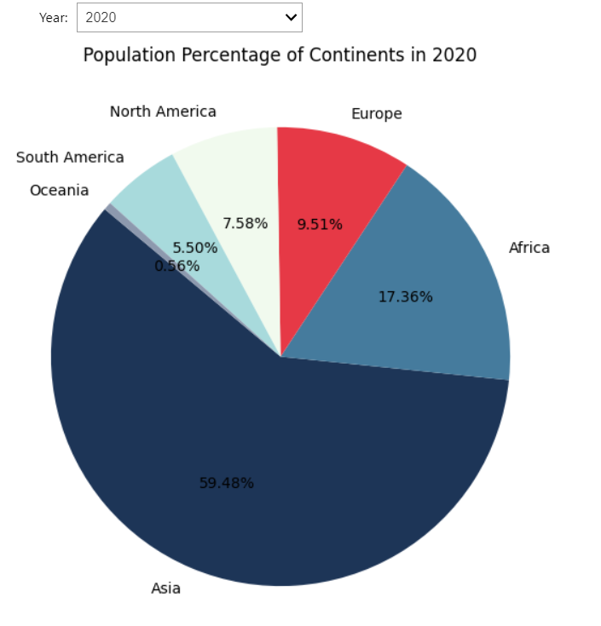
Analysis | Continent-wise Population Percentage by Year : 2020
Here, Asia hold most percentage of total population in the world.
In 2020 population percentage of continents are :
Asia – 59.48 %
Africa – 17.36 %
Europe – 9.51 %
North America – 7.58 %
South America – 5.50 %
Oceania – 0.56 %
12

Slide 13
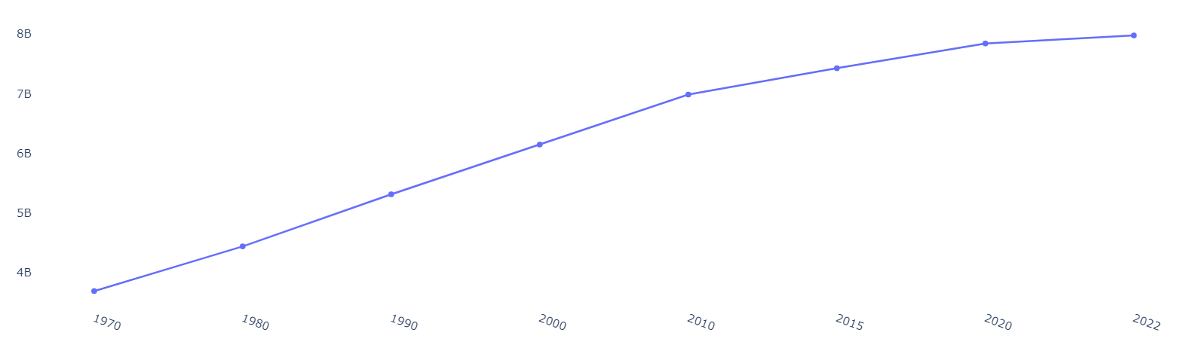
Analysis | World Population Trend (1970 – 2022)
Here, population trend in the world is increasing drastically in year-wise. In 1970, it was near about 4 Billion and now in 2022, it became near about 8 Billion.
13

Slide 14
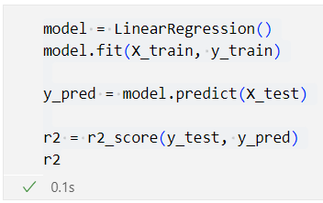

Analysis | Machine Learning Model : Linear Regression to Predict Population
Linear Regression :
Using Linear Regression, the accuracy was almost 96 %, which was very good to prediction.
The predicted population of India in 2030 is : 1108.84 Million
R2 Score : 96.30 %
14

Slide 15
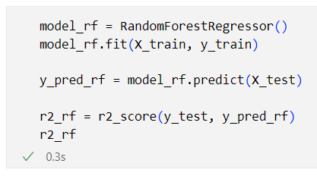

Analysis | Machine Learning Model : Random Forest to Predict Population
Random Forest :
Using Random Forest , the accuracy was almost 98 %, which was very good to prediction.
The predicted population of India in 2030 is : 1380.60 Million
R2 Score : 98.69 %
15

Slide 16
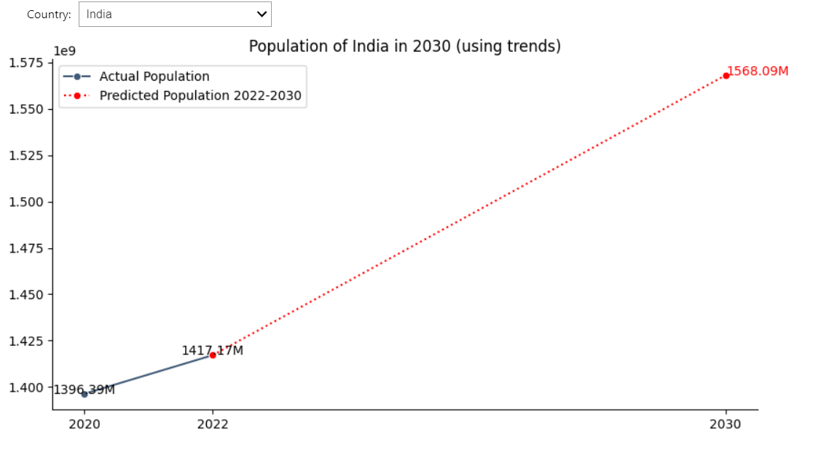
Analysis | Numpy Population Trend Prediction : India in 2030
Using numpy and formula : mx + b to analysis the trend and predict the population in 2030.
In 2020 and 2022, population was 1396.39 M and 1417.17 M respectively.
According to trend of population growth, the population of India in 2030 will be : 1568.09 M
16

Slide 17
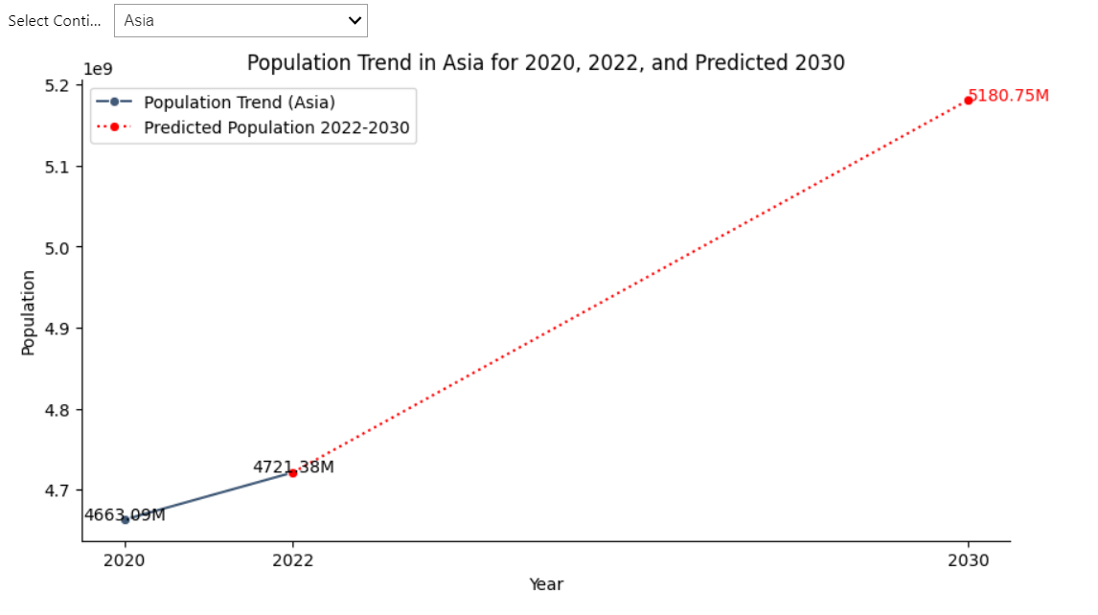
Analysis | Numpy Population Trend Prediction : Asia in 2030
Using numpy and formula : mx + b to analysis the trend and predict the population in 2030.
In 2020 and 2022, population was 4663.09 M and 4721.38 M respectively.
According to trend of population growth, the population of Asia in 2030 will be : 5180.75 M
17

Slide 18
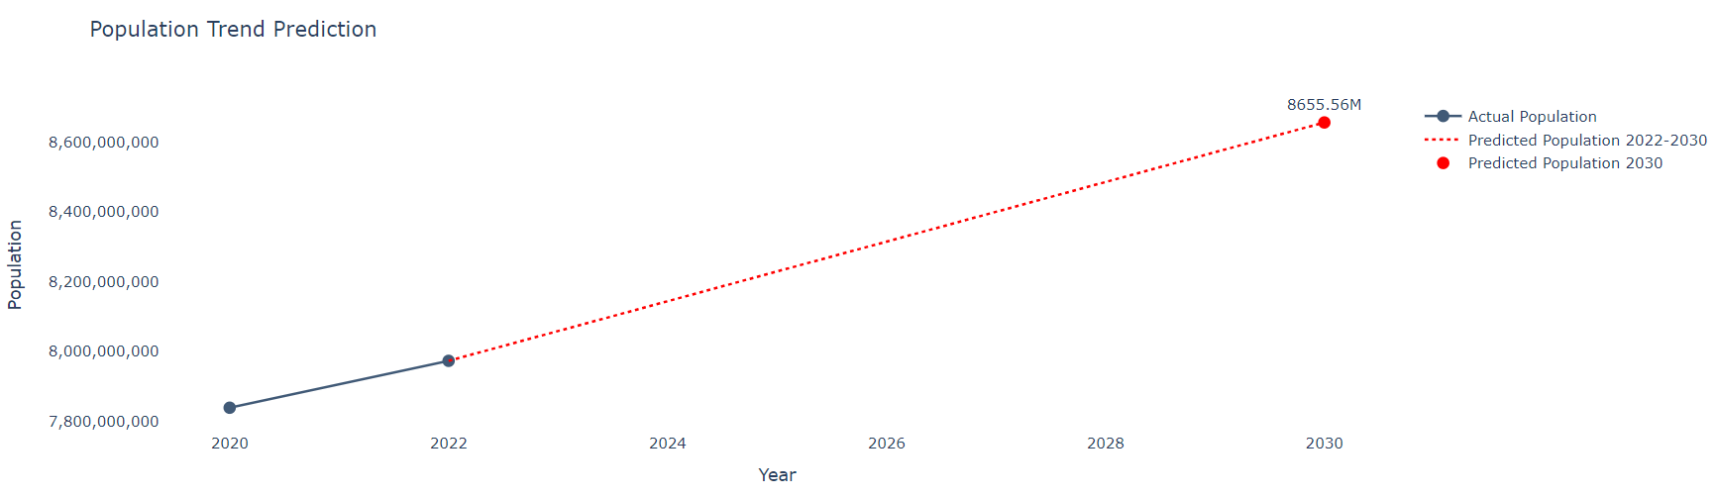
Analysis | Numpy Population Trend Prediction : World in 2030
Using numpy and formula : mx + b to analysis the trend and predict the worldwide population in 2030. According to trend of population growth, the population of World in 2030 will be : 8655.56 M
18

Slide 19

Summary
After the analysis of data, it is clear that the population of world is increasing drastically, which may lead to huge population density in many countries.
China and India became the most populated country in the world. In 2020, their population was 1424.93 M (38.97 %) and 1396.39 M (38.19 %) respectively.
Among all continents, Asia became the most populated continent in the world, population was in 2020 : 4663.09 M (59.48 %)
In whole world, population also increasing fast. In 2030, the population of world would be 8655.56 M
19

Slide 20




Thank You
Akashdeep Dam
akashdeepdam@gmail.com
UNID : UMIP20537

